Slide 1

RiskAssess
New features, Tips & Best Practices
Upcoming Inventory / Register
James Crisp

Slide 2
New features and Tips

Slide 3
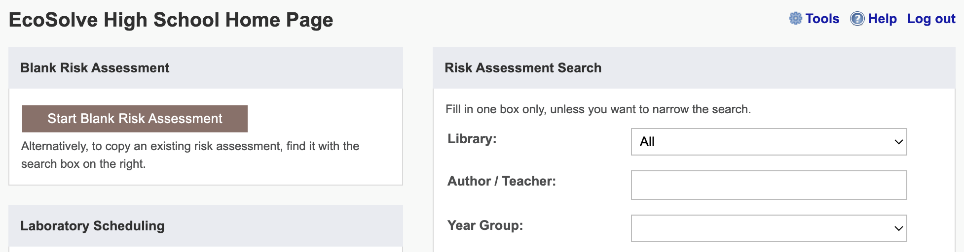
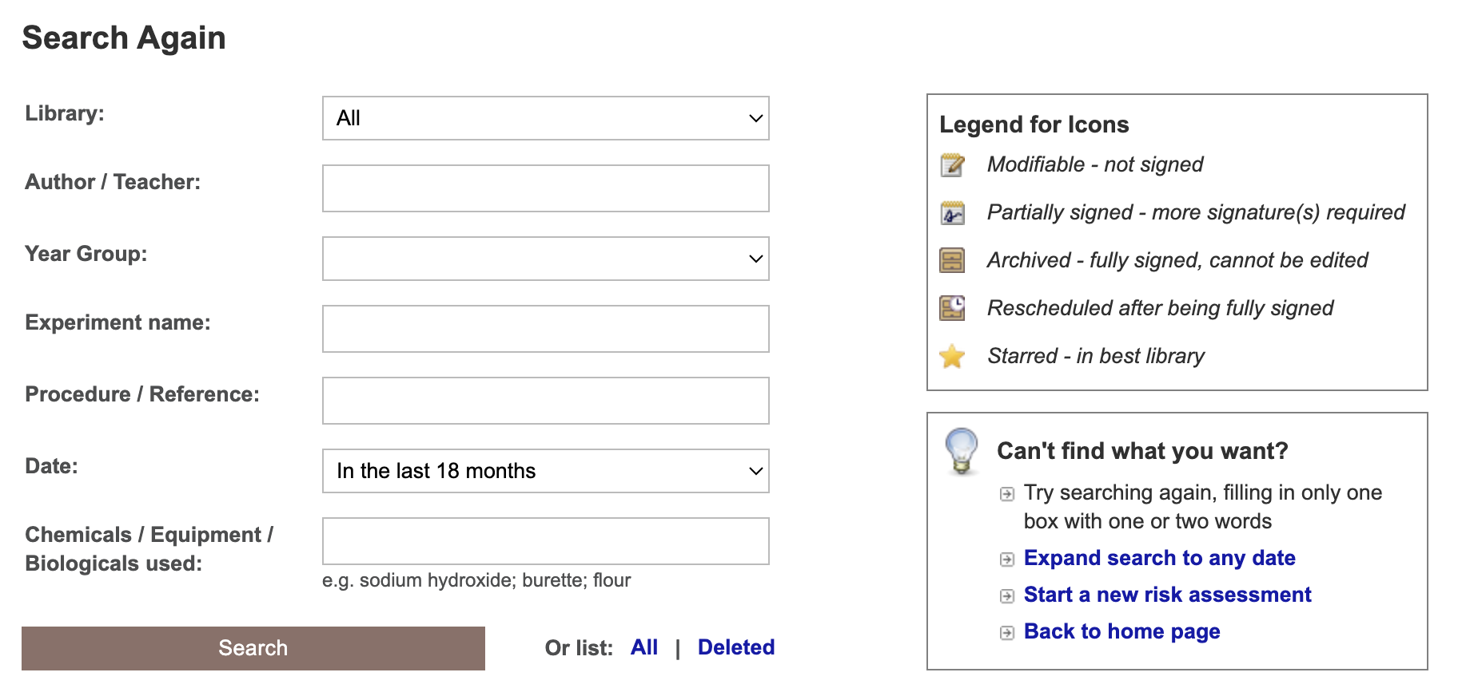
Notes:
Learning resources, videos & faq. And Phillip’s book!

Slide 4
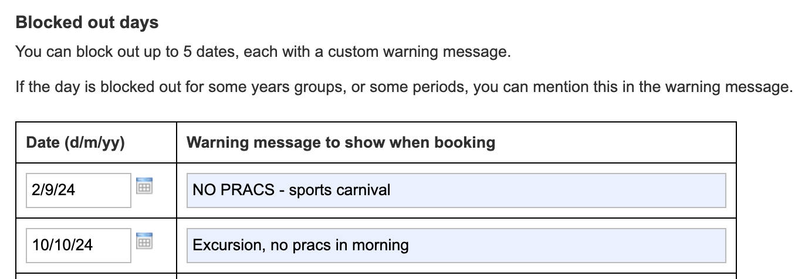

Now up to 10 dates!

Slide 5
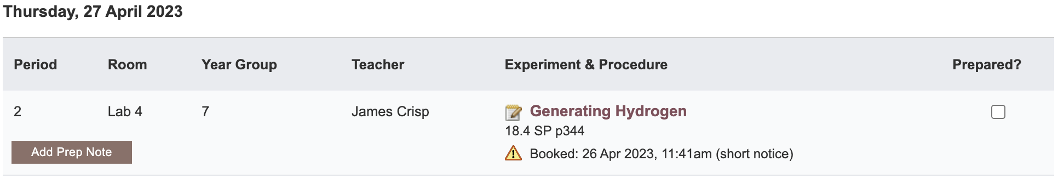

Slide 6
Tools demo including stocktaking & year groups

Slide 7
Share Superuser
Create a library of risk assessments to share between schools

Slide 8
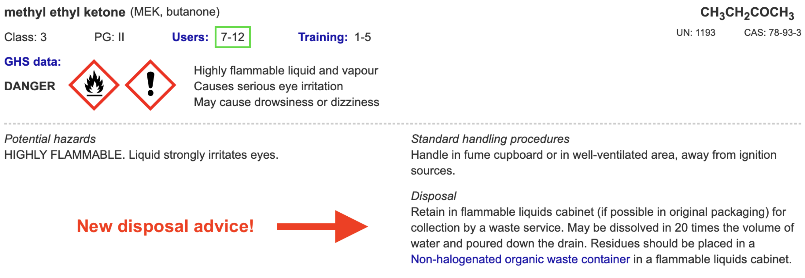
Disposal
Advice for all 3000 chemicals and solutions
Guide to disposal and waste container details
NEW Waste container labels!

Slide 9
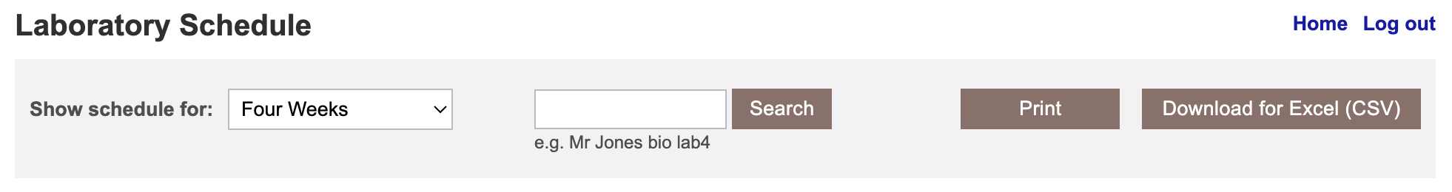
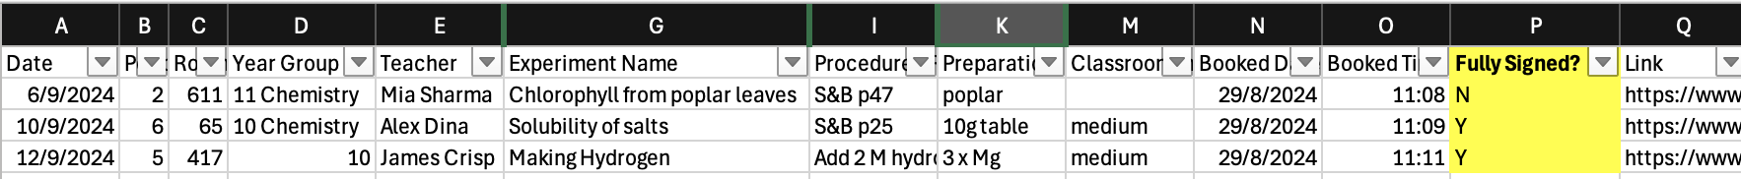
Notes:
Fully signed, but lots of other things like stats, high risk etc

Slide 10
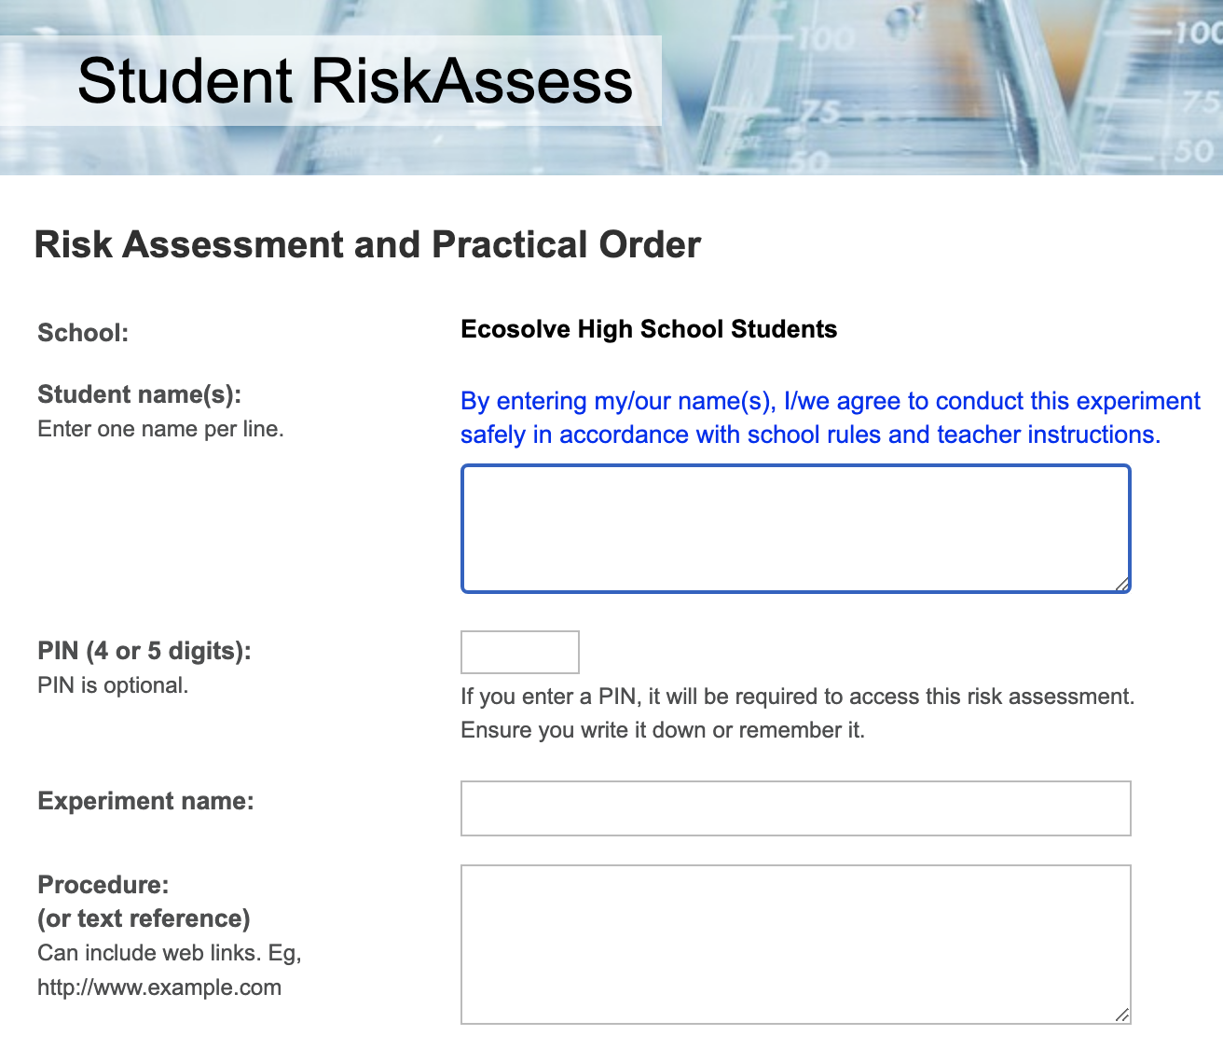

Slide 11
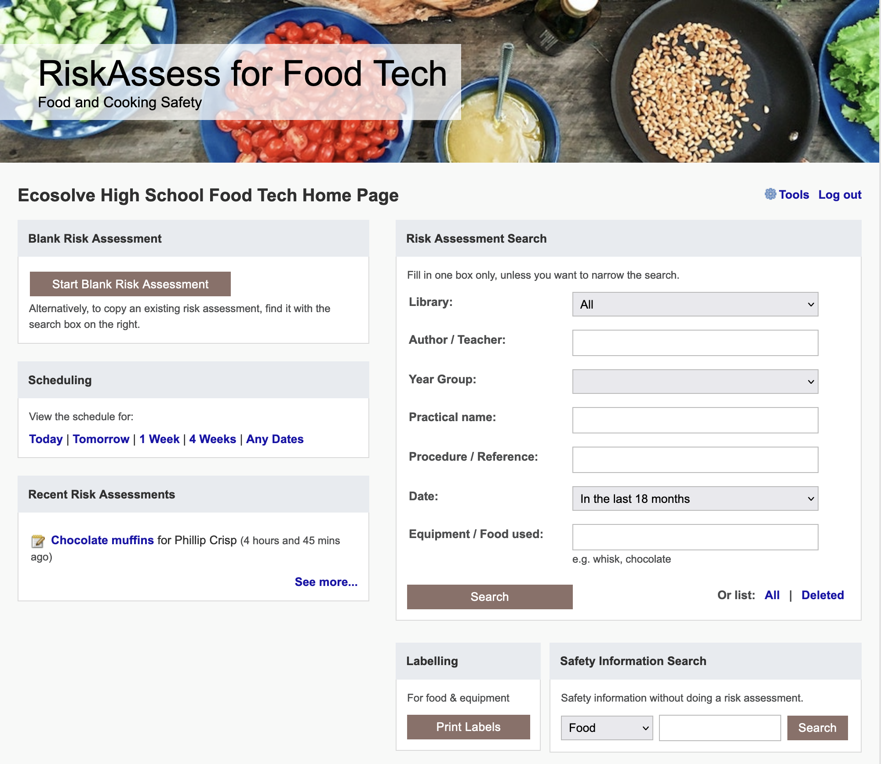

Slide 12
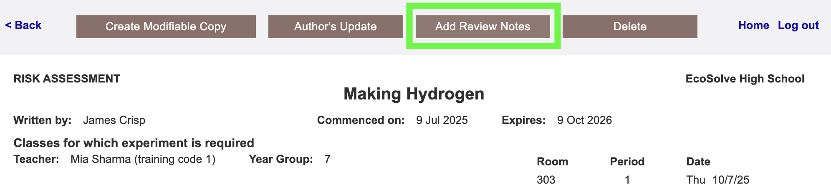
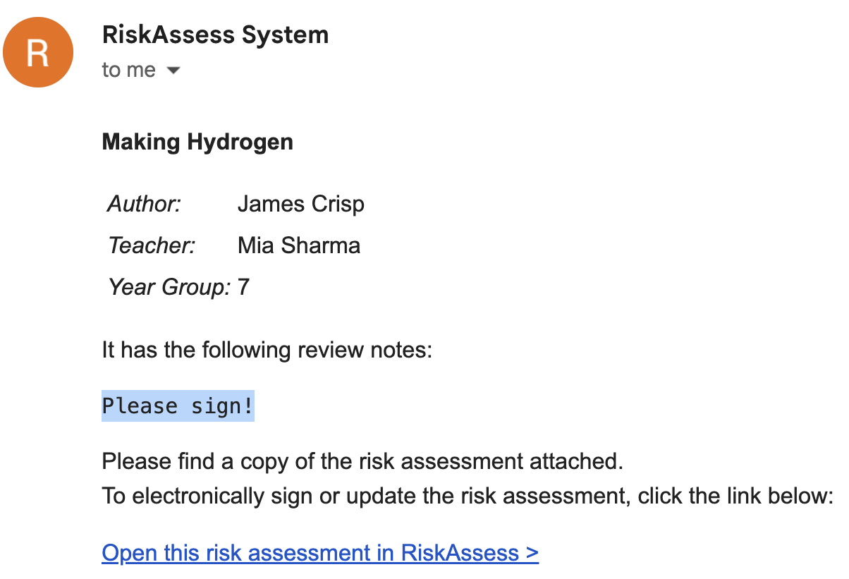

Slide 13
Best practices

Slide 14
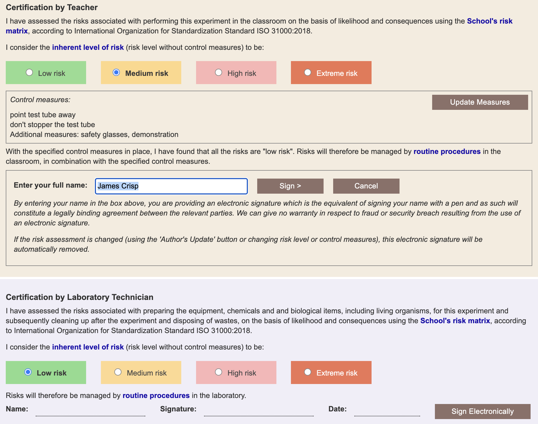
Notes:
more legal protection, not less for teachers

Slide 15
Multiple classes on
ONE SINGLE .
Risk Assessment
Notes:
Multiple scheduling is designed for an experiment that continues over several occasions with the same teacher, in the same location, and with the same class, e.g. observation of seed germination and growth over days or weeks.
Don't use multiple scheduling rows when different classes or different teachers are doing the same experiment. Instead, use 'Create modifiable copy' and carry out a separate risk assessment for each experiment. The reason is that both the law and logic require that all 'relevant matters' be considered when carrying out a risk assessment and these may be different with different classes, locations or teachers. The 'relevant matters' that need to be considered for an experiment include the facilities available (e.g. fume cupboard), the behaviour of the class (a big factor!), students with allergies, students with special needs, teacher experience and skill, etc. These matters will often be different from class to class, teacher to teacher and for different locations. 'Create Modifiable Copy' is fast and efficient to use, as details are carried across from the original risk assessment, ready to be customised for all 'relevant matters'.

Slide 16
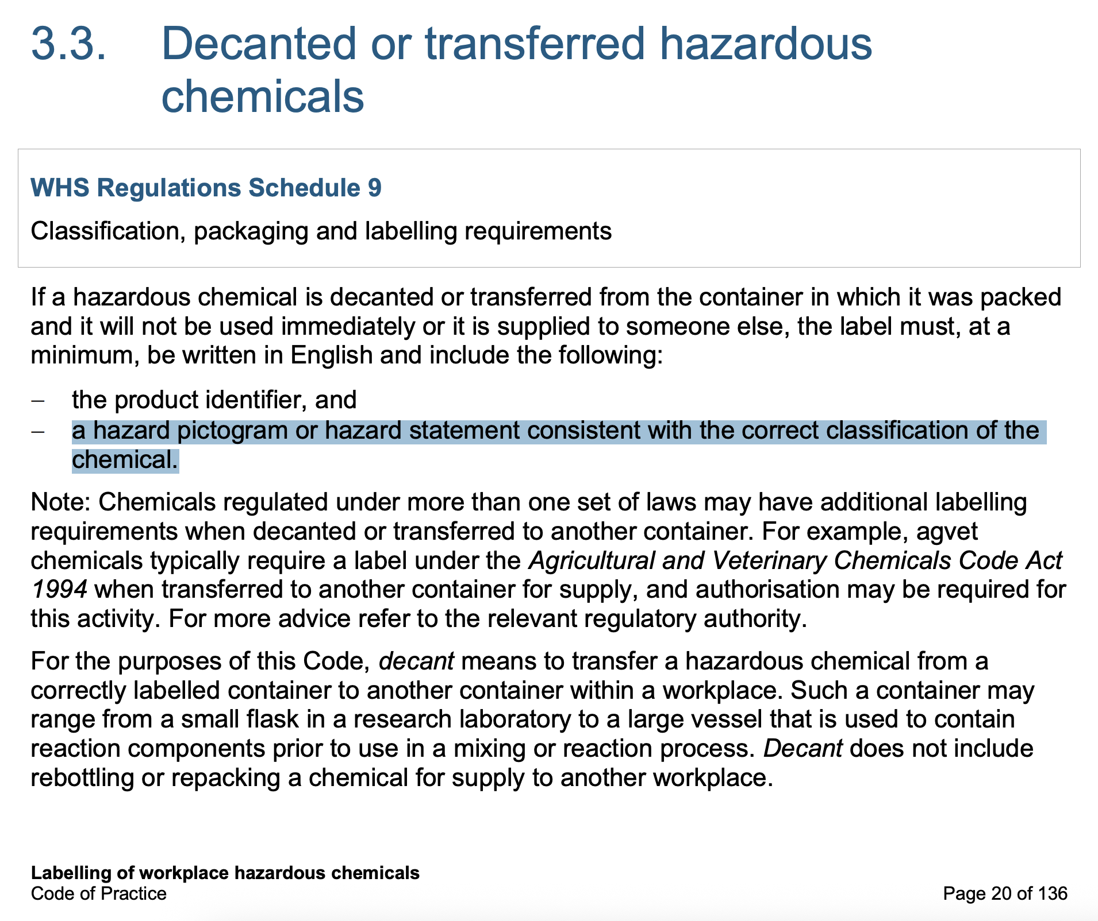
Notes:
https://www.safeworkaustralia.gov.au/sites/default/files/2023-06/model_code_of_practice_labelling_of_workplace_hazardous_chemicals.pdf
https://www.riskassess.com.au/info/faq#What_is_required_on_a_GHS_compliant_labe
What is required on a GHS compliant label? RiskAssess labels have bigger pictograms and less text?
According to the "Labelling of workplace hazardous chemicals Code of Practice" by Safe Work Australia (July 2020), reagent bottles in a school science laboratory would be regarded as "Decanted or transferred hazardous chemicals", meaning that a hazardous chemical has been decanted or transferred from the container in which it was packed and it will not be used immediately or it is supplied to someone else. For such a chemical, a label is required which must, at a minimum, be written in English and include the following [Section 3.3]:
the product identifier, and
hazard pictogram or hazard statement consistent with the correct classification of the chemical.
There is guidance for the orientation and size of label elements in the Code of Practice [Section 4.2]. For containers up to 500 mL capacity, the minimum pictogram size is 15 x 15 mm and the minimum text size is 2.5 mm. For containers 500 mL to 5 L capacity, the minimum pictogram size is 20 x 20 mm and the minimum text size is 3 mm. Otherwise, hazard pictograms and text may be in any size and style that is easily legible and is appropriate to the size of the label and container.
In RiskAssess, we have chosen to:
include the Signal word, since it provides a rapid summary of the hazard level
use pictograms, rather than hazard statements, since they are more readily understood
add hazard statements when there is sufficient room
focus on communicating the most essential information.

Slide 17
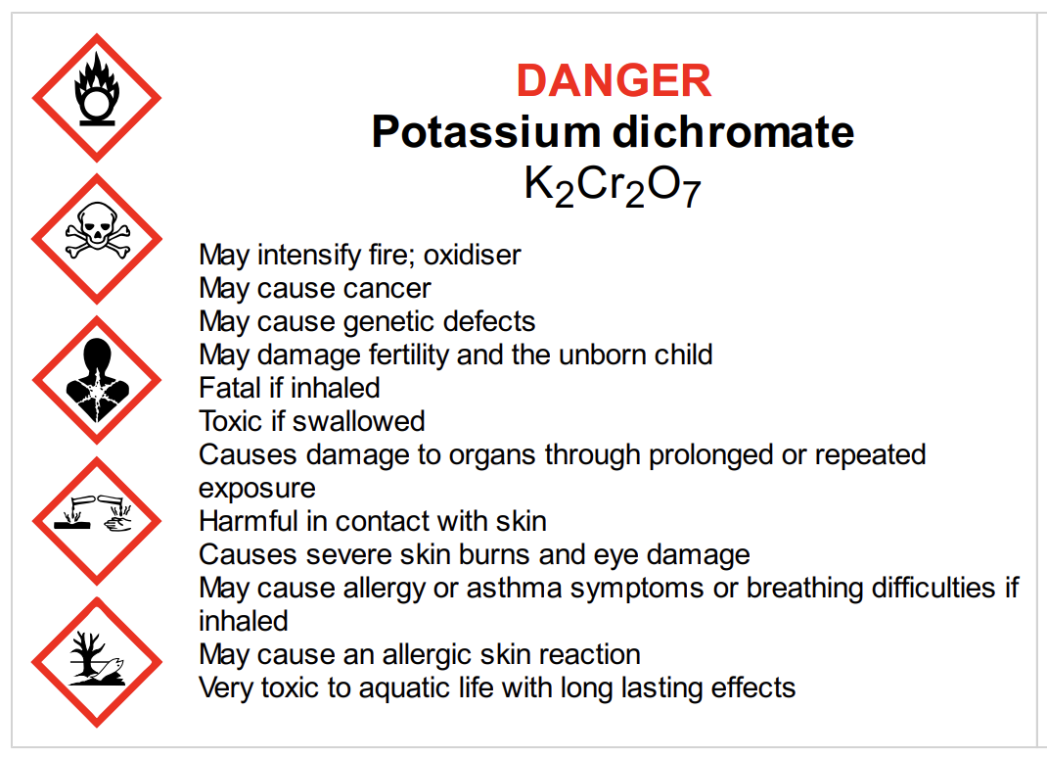
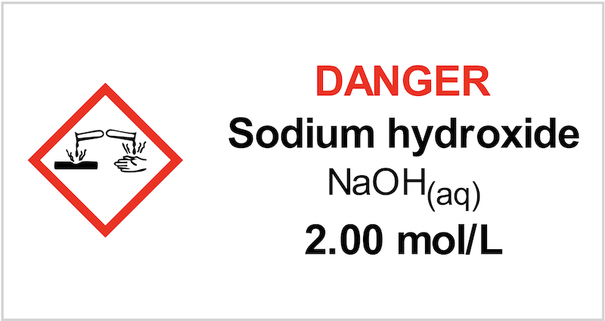
In RiskAssess, we have chosen to:
include the Signal word, since it provides a rapid summary of the hazard level
use pictograms, rather than hazard statements, since they are more readily understood
add hazard statements when there is sufficient room
focus on communicating the most essential information.
Notes:
https://www.safeworkaustralia.gov.au/sites/default/files/2023-06/model_code_of_practice_labelling_of_workplace_hazardous_chemicals.pdf
https://www.riskassess.com.au/info/faq#What_is_required_on_a_GHS_compliant_labe
What is required on a GHS compliant label? RiskAssess labels have bigger pictograms and less text?
According to the "Labelling of workplace hazardous chemicals Code of Practice" by Safe Work Australia (July 2020), reagent bottles in a school science laboratory would be regarded as "Decanted or transferred hazardous chemicals", meaning that a hazardous chemical has been decanted or transferred from the container in which it was packed and it will not be used immediately or it is supplied to someone else. For such a chemical, a label is required which must, at a minimum, be written in English and include the following [Section 3.3]:
the product identifier, and
hazard pictogram or hazard statement consistent with the correct classification of the chemical.
There is guidance for the orientation and size of label elements in the Code of Practice [Section 4.2]. For containers up to 500 mL capacity, the minimum pictogram size is 15 x 15 mm and the minimum text size is 2.5 mm. For containers 500 mL to 5 L capacity, the minimum pictogram size is 20 x 20 mm and the minimum text size is 3 mm. Otherwise, hazard pictograms and text may be in any size and style that is easily legible and is appropriate to the size of the label and container.
In RiskAssess, we have chosen to:
include the Signal word, since it provides a rapid summary of the hazard level
use pictograms, rather than hazard statements, since they are more readily understood
add hazard statements when there is sufficient room
focus on communicating the most essential information.

Slide 18
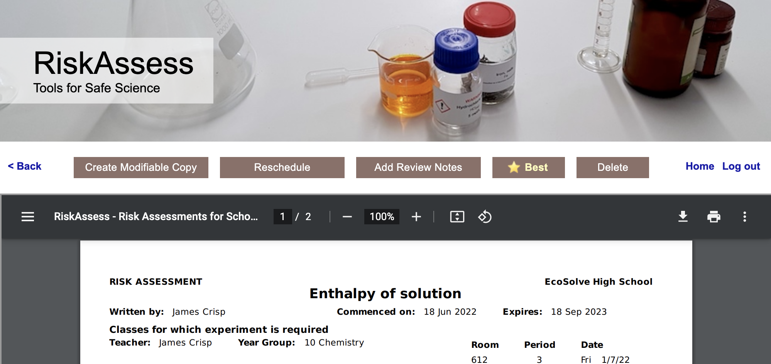
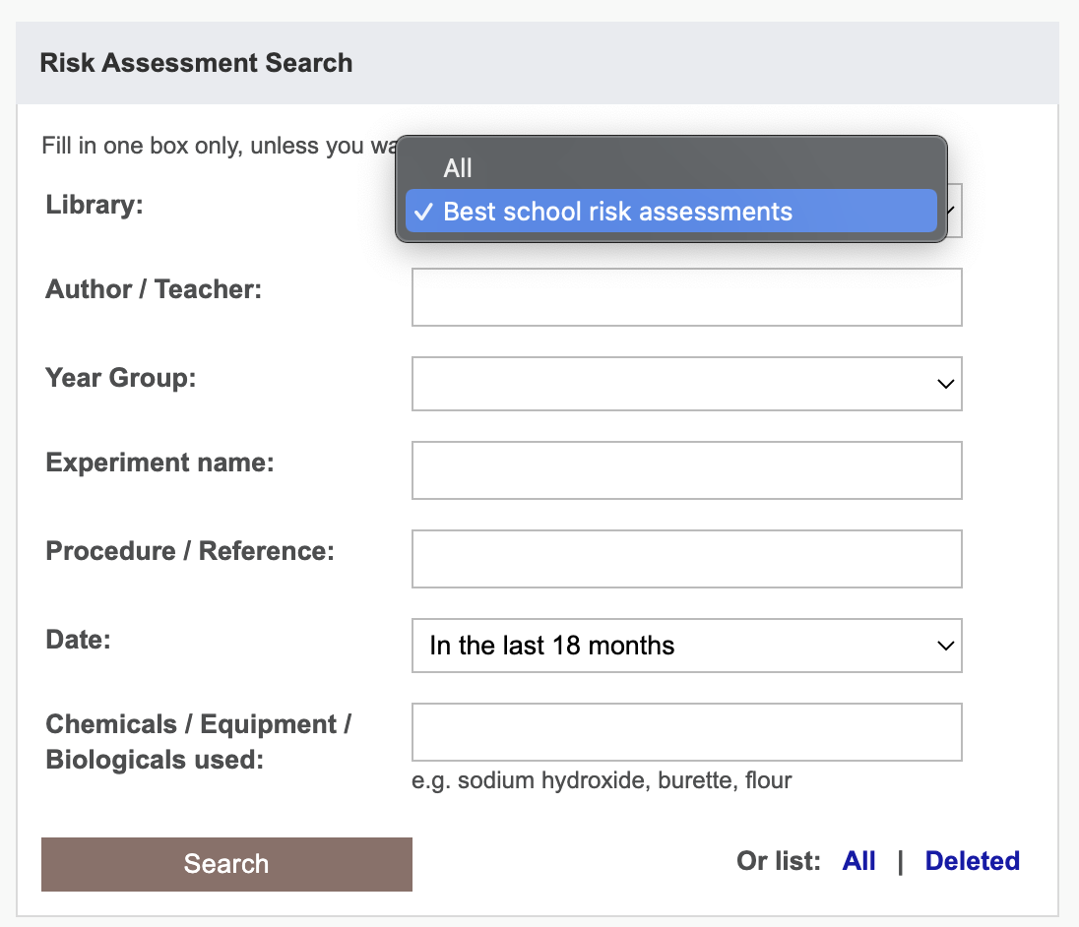
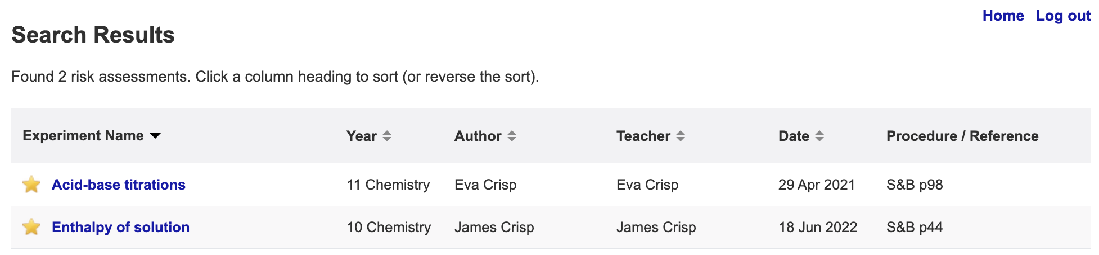
Notes:
BEST/Starred instead of delete

Slide 19
Future Plans

Slide 20
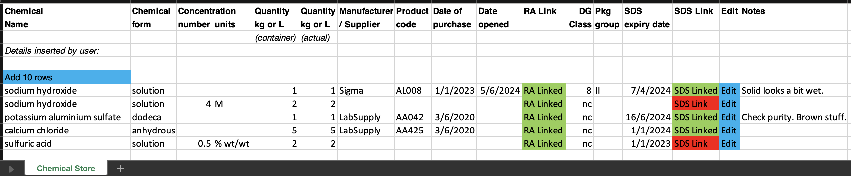
Chemical Register DRAFT
Links to RA safety info & SDS
Import from CSV/template/Chemwatch
Easy print out
Reports/Colours for SDS that need updating
Building (list), room (list), location (text)?
Access for outside Science (read-only link for all, editable link per department)?
Notes:
But I have something better to show you!

Slide 21
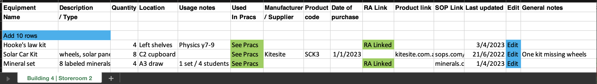
Equipment Inventory DRAFT
Building (list), room (list), location (text)?
Import from CSV/template
Easy print out
Anything missing?

Slide 22
Tips & Tricks

Slide 23
Menu
Shortcuts
icons, hcl, part name, day/month,
click banner, links, hot links, delete,
Best RAs, search on less, # & sort
Scheduling
Excel/csv, any dates, last week,
search, no# pracs, prep notes,
double booking, lodged date
Tools
customise year groups,
stocktaking & usage, invoice,
backup system, defaults
Resources
learning resources, faq, eBook,
videos, libraries: Stile+EP+Edrolo
Labels
standard & custom labels
multiple chemicals on sheet
mixtures, non-chemicals
free text, biohazard symbol
Operations
reschedule, archive risk
assessments, annual review,
tech-only RAs, review notes,
high/extreme: 3 signatures, list
Multiple classes
author update/modifiable copy
Student RiskAssess
view student PINs, not last year
multiple prac management

Slide 24
Questions?

Slide 25
From Phillip…
We follow the data in the ECHA database, which records the classifications of chemicals according to GHS from all over Europe and Scandinavia.
It is a strength that the database is continually updated as new information becomes available, but it is a hassle sometimes when things change!
I wrote CSIS Appendix D in 1991, using data that were then available, and it was published in 1993.
There have been improvements in our understanding of chemical hazards in the past 34 years!
As far as I am aware, the original data in CSIS have not been updated, although it is now available online.

