Slide 1
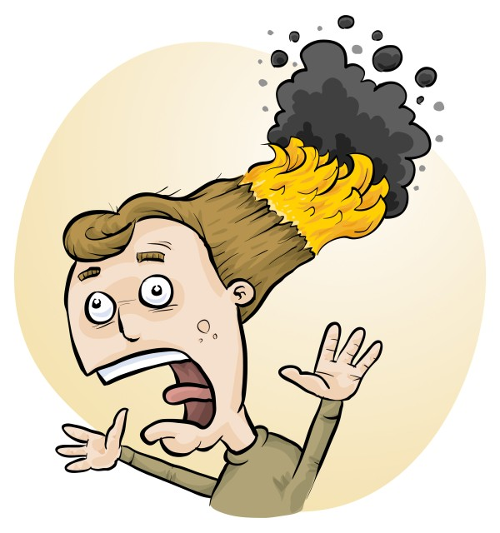
RiskAssess for Food Tech
Phillip and Eva Crisp

Slide 2
• burns
• cuts
• allergies
• slips, trips, falls
• fires
• fumes, vapours
• eye injuries
• cleaning chemicals
• electric shock, food poisoning, . . .
Kitchen hazards

Slide 3
• assess the risks
• introduce control measures
Given the hazards . . . .
it seems like a good idea to
This is required by law

Slide 4
Work Health & Safety Act 2011
. . . a duty . . . to eliminate/minimise risks to health and safety as far as is reasonably practicable.
. . . taking into account and weighing up
all relevant matters including:
(a) the likelihood of the hazard or the risk concerned occurring; and
(b) the degree of harm that might result from the hazard or the risk
. . . .
Part 2, Sections 17 and 18

Slide 5
The law
Risk assessments must take into account
all relevant matters including
facilities available
behaviour of the class
students with special needs
students with allergies, etc
Each class doing each activity should be the subject of a separate risk assessment

Slide 6
• reduce injuries
• increase legal protection
Why do risk assessments?

Slide 7
Risk assessment
To assess the severity of a risk,
you need to consider:
• the consequences of the event, and
• the chance that it will occur (likelihood)
Severity (risk level) may be
Low Medium High Extreme
AU ISO 31000:2018 “Risk management”
Risk matrices used in schools are 3 x 3 to 5 x 5
See www.riskassess.com.au/learning_resources

Slide 8
Assess risks
≥Medium
risk level
Low
risk level
Add control measures
DO
ACTIVITY
Inherent level of risk
= risk level without any control measures besides “routine procedures”
Residual level of risk
= risk level with control measures in place

Slide 9
What is RiskAssess for Food Tech?
• web-based risk assessment tool
- customised to the school situation
- electronic templates (AU/ISO)
• safety information on 1000 food items
and 600 kitchen equipment items
• shopping lists
- AI unit conversion, stored densities
- combined lists, e.g. week’s shopping
• ordering, scheduling & labelling
• recipe storage and sharing

Slide 10
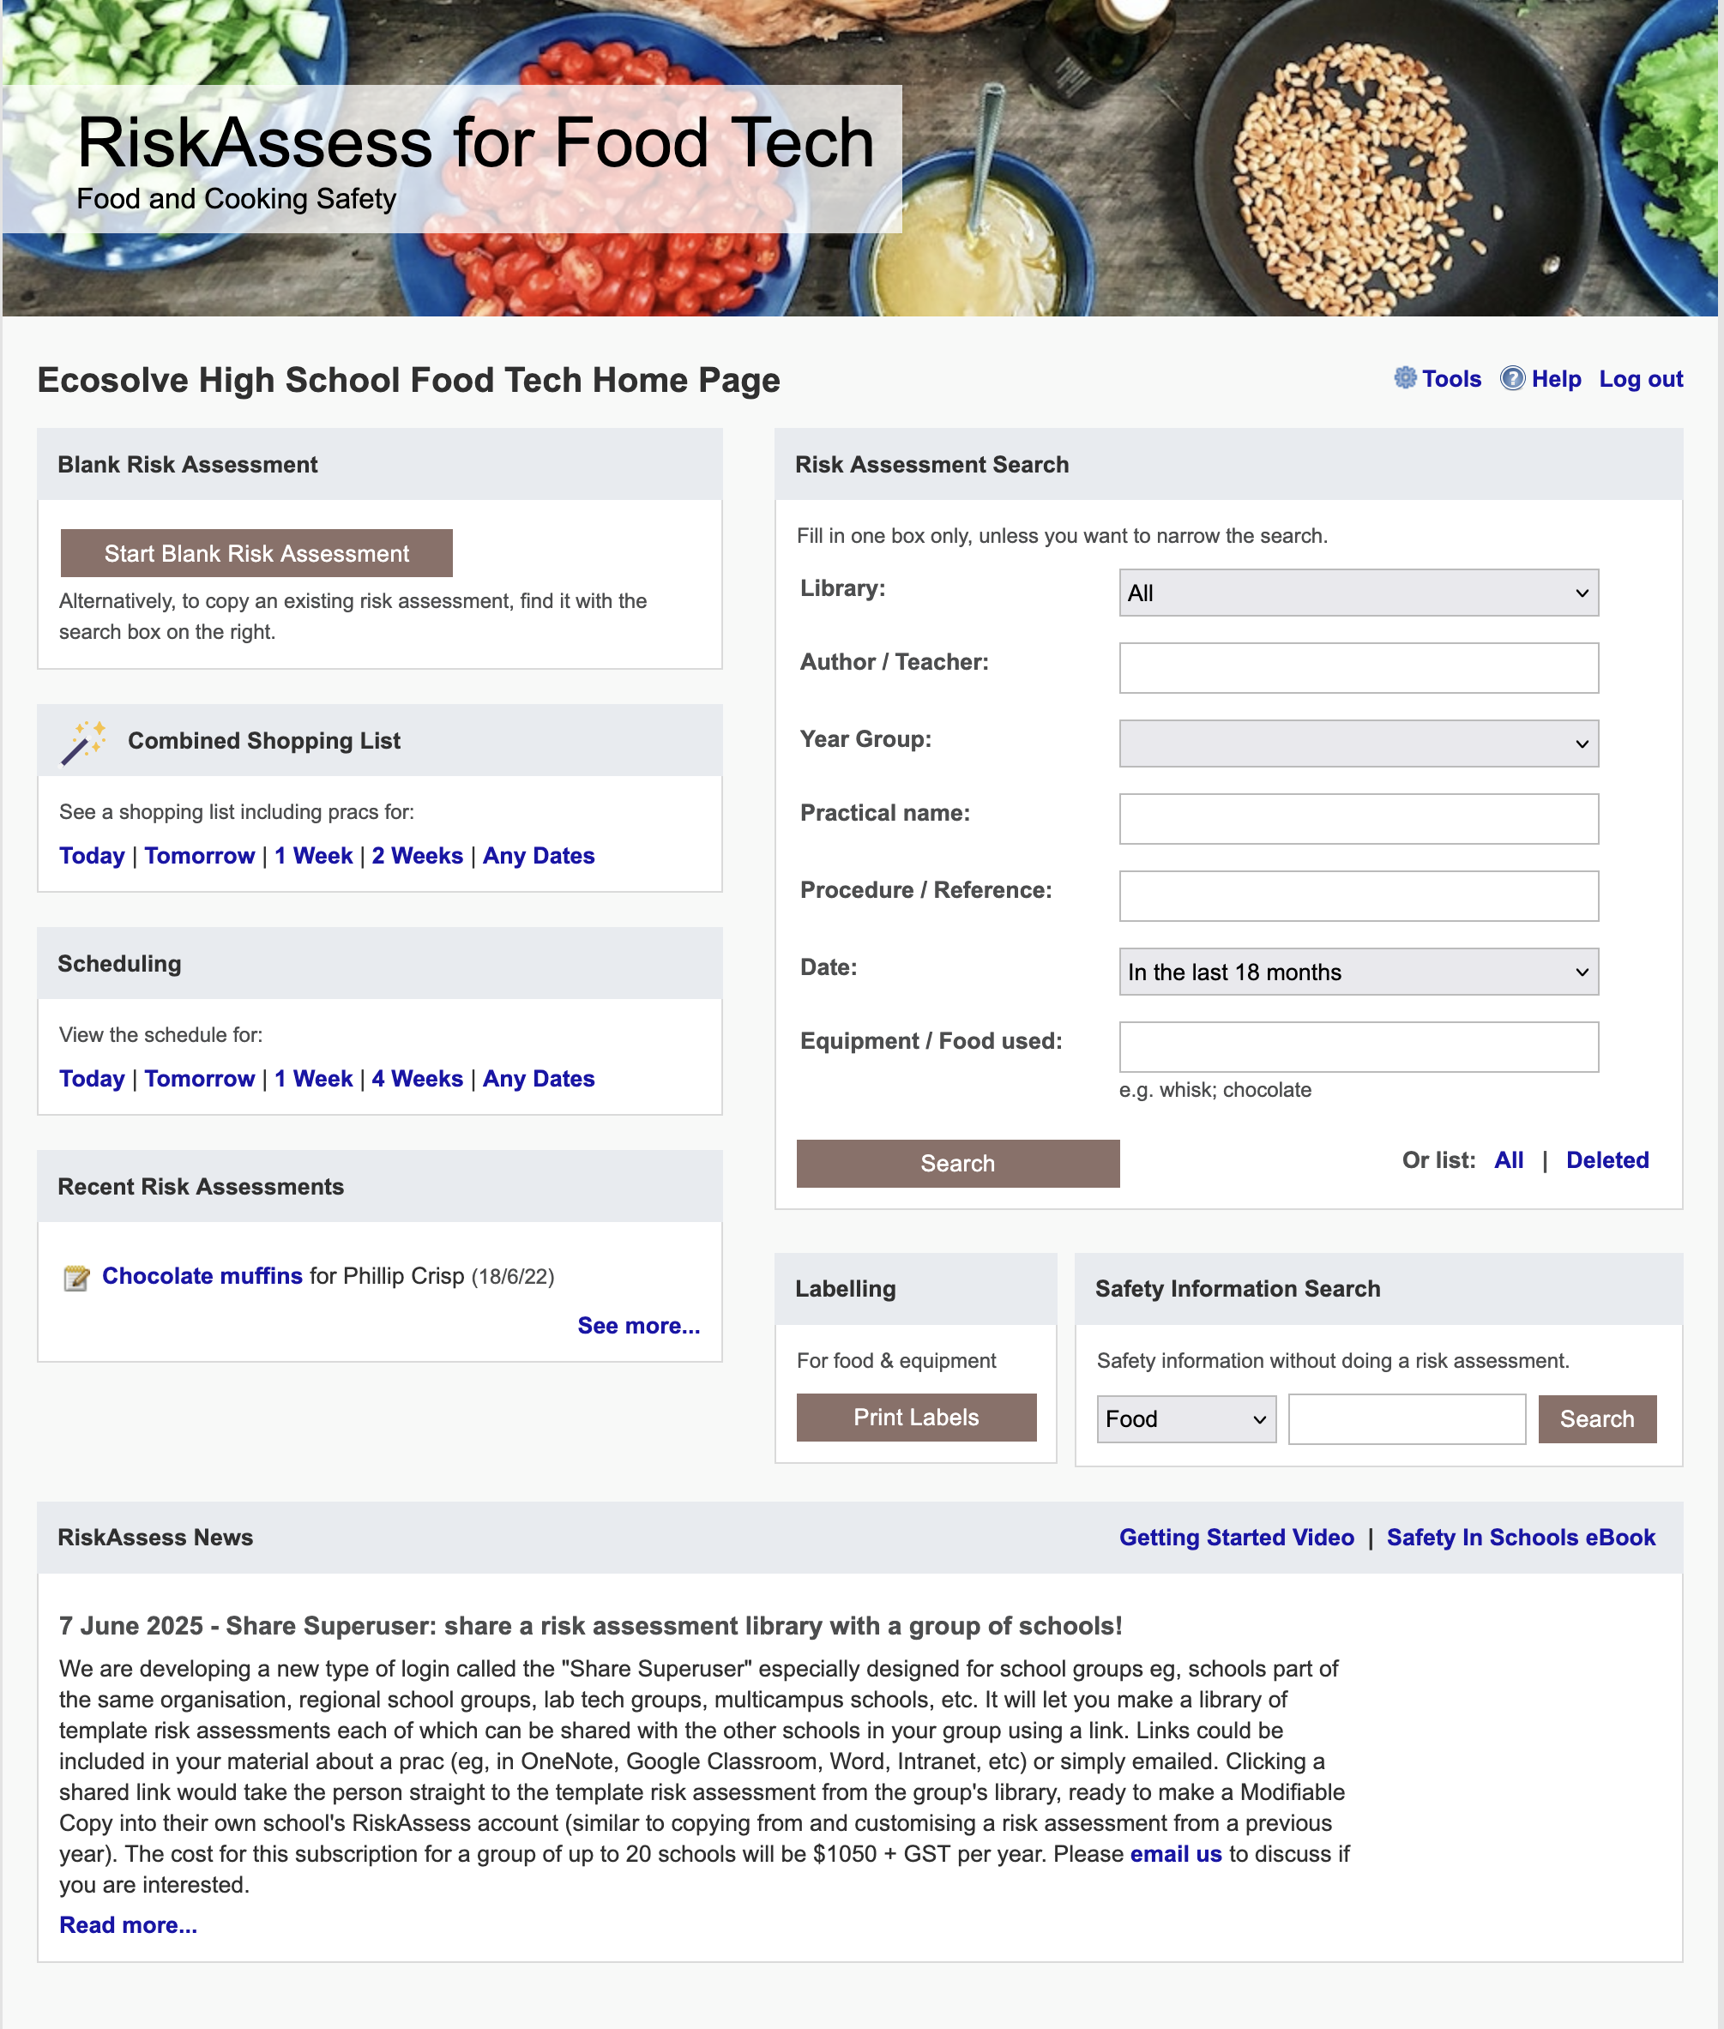
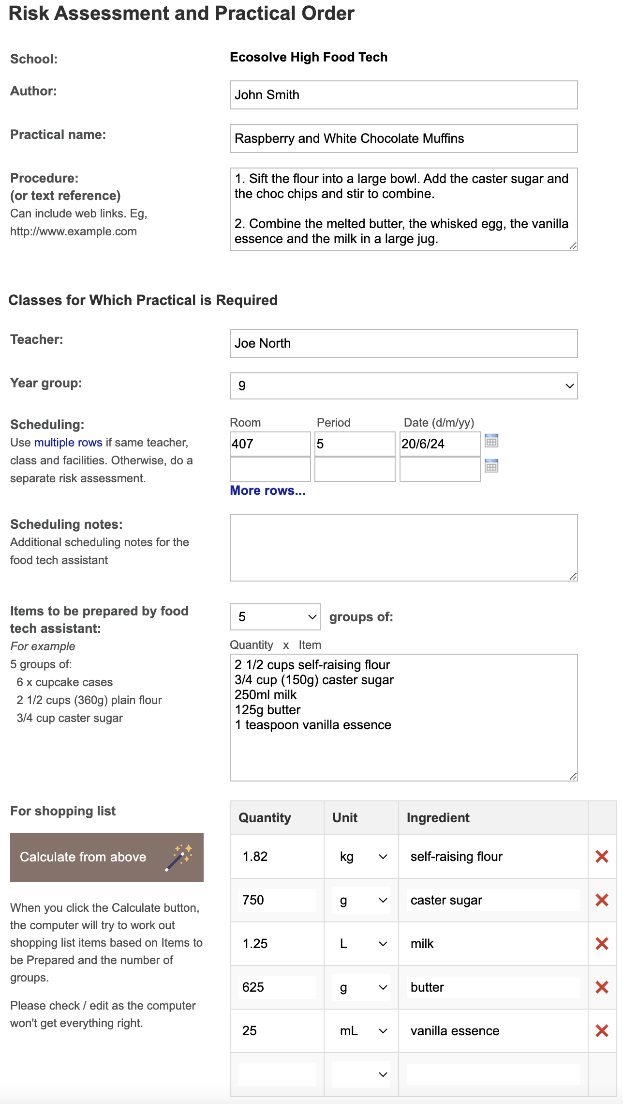

Slide 11
Logic
Risk Assessment (LEGAL)
• separate sections for teacher and assistant
• initial assessment of inherent risk
- if low, go to end
- if medium or more, record control measures
- if high or extreme, third reviewer required
• cross-checking by teacher/assistant/reviewer
Practical help (SAVE TIME)
• shopping lists
• recipe storage and sharing
• scheduling & ordering
• labelling

Slide 12
Electronic system
• relatively rapid
• prompts sensitive to context
• reduces paper consumption
• easy to review and update
• search and statistics
• long term storage
• demonstrated to work in schools
RiskAssess: 2,700 schools AU+NZ+CA
88% AU, 87% QLD
9,000,000 risk assessments
RAFT: >100 schools, 21,000 RAs

Slide 13
Details
• access from school/home
• nothing to install on computer, tablet or phone
(instant update)
• unlimited number of simultaneous users and risk assessments
• minimal data entry
• continuing input from Food Tech staff
• multiple backups of data & backup server
• support and advice
• inexpensive ($350+GST per campus per year)

Slide 14
DEMO

Slide 15
Conclusion
• BY LAW, risk assessments must be carried out for all school activities
• RiskAssess offers the fastest/easiest way
_____________________
• BONUS: RiskAssess also provides
• weekly shopping lists
• recipe storage and sharing
• scheduling
• prac ordering
• labelling
Simpler
than other
systems

